Slide 1
Deployment Project
Alex Kobetich

Slide 2
Goal
To predict loan eligibility based on customer details

Slide 3
Exploratory data analysis

Slide 4
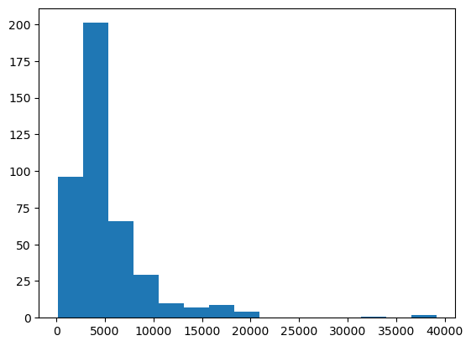
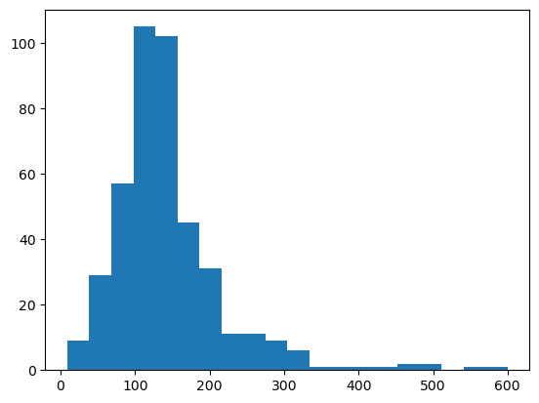
Distribution of Applicant Income
Distribution of Loan Amount

Slide 5
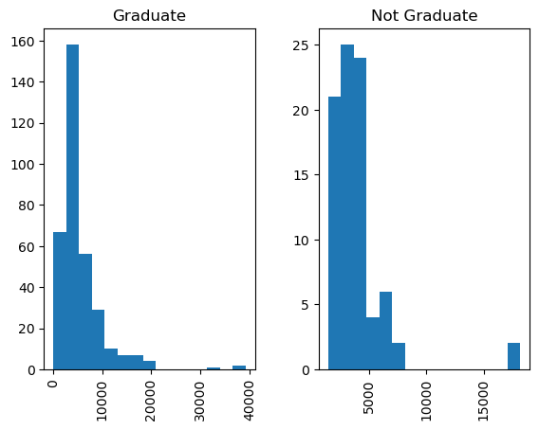
Distribution of Applicant Income by Education

Slide 6
Process
EDA
Numerical features: NaN’s replaced with mean, scaled
Categorical Features: NaN’s replaced with mode, one-hot-encoded
Pipeline: Logistic regression, SVC, select k-best
Deployment

Slide 7
Final Model
Test set accuracy: 0.813
Achieved with Logistic Regression and 3 features

Slide 8
Challenges
issues with flask/API

Slide 9
Future Goals
Deeper look into the features
Try other models

